Slide 1

Lecture 03 Custom Networking Part 3
Remote Method Invocation
Book: Chapter 13- Object Streams and RMI
(The java.rmi package)

Slide 2
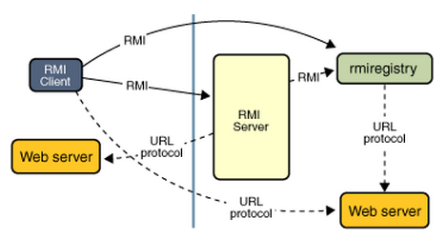
Why should we study this lecture?
Nowadays, distributed applications are popular. People need large applications, running based on a computer network (local area networks-LANs- or wide area network-WAN), including many sites working concurrently. Do you want to create such applications?
How do Java distributed applications work?
From Java8-Tutorial

Slide 3
Contents
Object Streams and Serialization
Java Remote Method Invocation (RMI)
Demonstrations

Slide 4
1- Object Streams & Serialization
Serialization: a process that converts object’s state to a byte stream .
Do you want to make yourself the way of serialization instead of the Java default one?
java.io.Serializable : no method is declared
java.io.Externalizable:
Methods are declared in the Externalizable Interface
void | readExternal(ObjectInput in) The object implements the readExternal method to restore its contents by calling the methods of DataInput for primitive types and readObject for objects, strings and arrays.
void | writeExternal(ObjectOutput out) The object implements the writeExternal method to save its contents by calling the methods of DataOutput for its primitive values or calling the writeObject method of ObjectOutput for objects, strings, and arrays.
A demonstration: Refer the book, page 446.

Slide 5
Remote Control Using Object Streams
Class Command
Operation
Operands
Class Result
…
Client
Create a Command object;
Connect to server
Write it to output stream of the socket
Wait for then get the result object from socket’s input stream.
Show the result.
Server
Wait for a connect from client
Get Command object from input stream of client socket.
Execute the command received to create a Result object
Write the result object to output stream of the client object
Demonstration: Book, page 447 .. 452

Slide 6
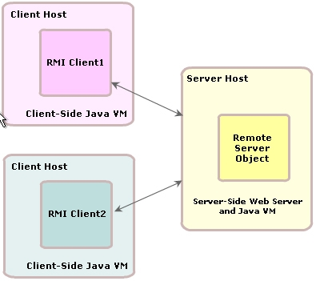
2- Remote Method Invocation (RMI)
The Java Remote Method Invocation (Java RMI) is a Java API that performs the object-oriented equivalent of remote procedure calls (RPC), with support for direct transfer of serialized Java classes and distributed garbage collection.
The original implementation depends on JVM class representation mechanisms and it thus only supports making calls from one JVM to another. The protocol underlying this Java-only implementation is known as Java Remote Method Protocol (JRMP).
It is the basic for protocols used in Java application server, JBoss for example.

Slide 7
RMI…
Server object
bind
Client object
Lookup server object
Server_Stub
RMI Container
Server database
[ Name1, serverObject1]
[ Name2, serverObject2]
…
response
Network
Environment
request
Client JVM
Server JVM
In Windows, RMI container, pre-defined in JDK, is the program rmiregistry.exe
We can create a RMI container by an Java object. See demo.

Slide 8
RMI…
Remote interface
Remote interface
Client
Server
Object A
Object B
The Stub, Skeleton is omitted from Java 1.6
Object B Stub
Object B Skeleton
R
E
M
O
T
E
R
E
G
I
S
T
R
Y
Remote Reference Layer
Remote Reference Layer
Transport Layer
Transport Layer
From Java 1.6, code for network communicating is implemented automatically

Slide 9
RMI…: 5 Steps
1- Create the remote interface
2- Create the remote class (server) implementing the remote interface.
3- Create Server program using server object
4- Create the client program
5- Run apps: Start server program first then the client program.

Slide 10
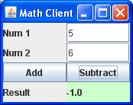
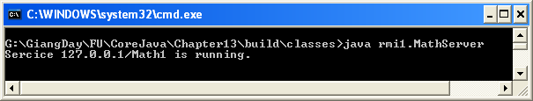
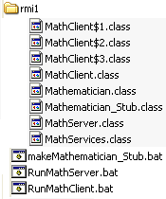

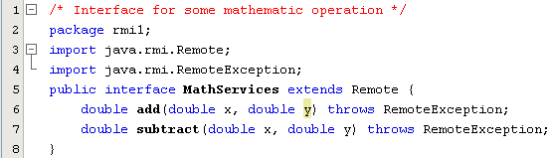



Demo 1: Simple RMI
The Stub, Skeleton is omitted from Java 1.6
Step 1: Create a remote interface

Slide 11
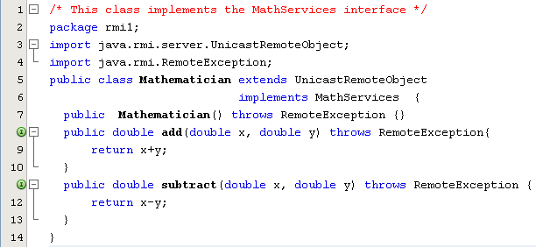
Demo 1: Simple RMI…
Step 2: Create server class implementing remote interface

Slide 12
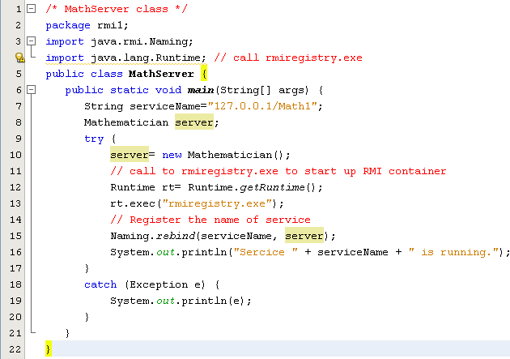
Demo 1: Simple RMI…
Step 3: Create server program in which a server object is used
URN: Uniform Resource Name

Slide 13
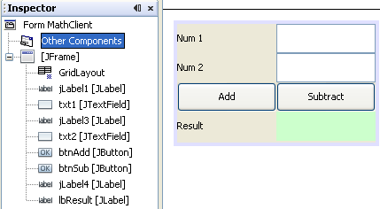
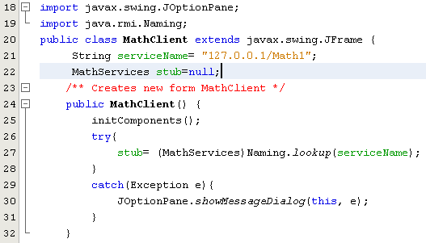
Demo 1: Simple RMI…
Step 4: Create client program in which the remote interface is used

Slide 14
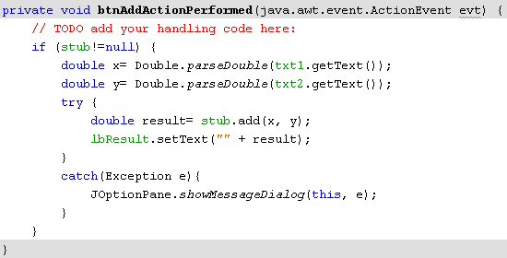
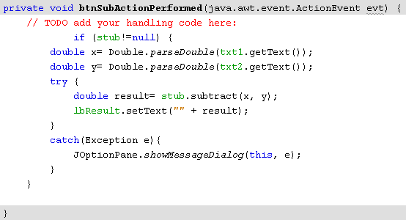
Demo 1: Simple RMI…
Call methods of remote object

Slide 15
Demo 1: Simple RMI…
Step 6: Run server program first then client program

Slide 16
Demo 1- Evaluation
Disadvantages
- Platform dependent
An exception is thrown when we run the server program again because rmiregistry.exe must be terminated after each run ( use task manager/ Processes)
In server program

Slide 17
Demo 1- Overcome Use the default RMI container in JVM
In server program
// Using default RMI container in JVM
import java.rmi.registry.LocateRegistry;
String serviceName = "rmi://localhost:1098/Math1";
LocateRegistry.createRegistry(1098);

Slide 18
Demo 1- Overcome Use the default RMI container in JVM
In client program
String serviceName= "rmi://localhost:1098/Math1";

Slide 19
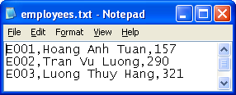
Demo 2: Data are stored in server
At server side
An initial list of employees is stored in the employees.txt file ( a line for an employee with the format: code, Name, salary).
A program running in console mode in which a remote server can support two operations:
Supply initial list of employees to a client program.
Save using override mode a list of employees transferred from a client program.

Slide 20
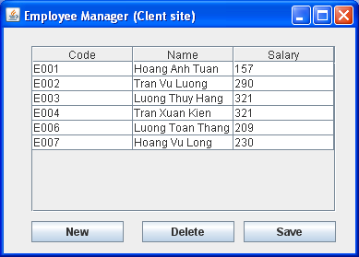
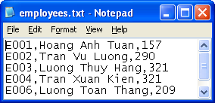
Demo 2…
At client side:
Initially, a list of employees is supplied from server will be presented on a table of the GUI.
User can
Add new employee ( the employee’s code must have the format E000 and it is not duplicated with existing employee codes.
Remove an employee.
Update employee details.
Save the list on server.

Slide 21
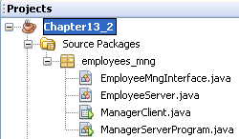
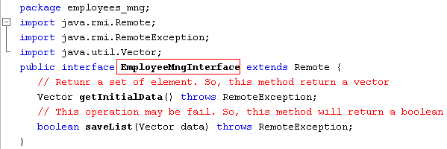
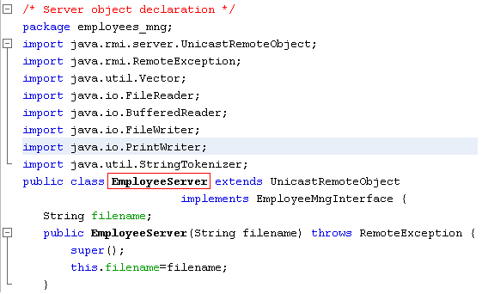
Demo 2: Remote Interface and Server Object

Slide 22
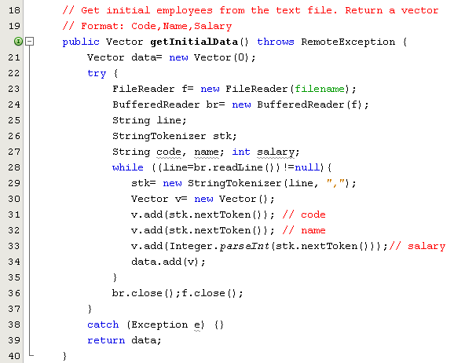
Demo 2: Server side

Slide 23
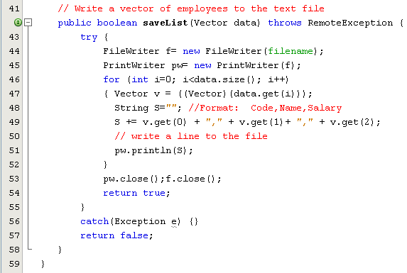
Demo 2: Server Object…

Slide 24
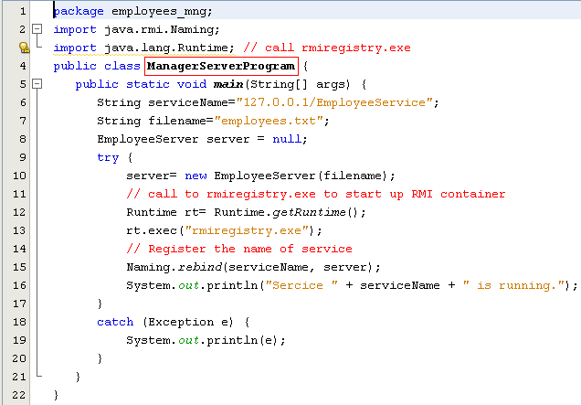
Demo 2: Server Program
Có thể thay bằng:
// Using default RMI container in JVM
import java.rmi.registry.LocateRegistry;
String serviceName = "rmi://localhost:1098/EmployeeService”
LocateRegistry.createRegistry(1098);

Slide 25
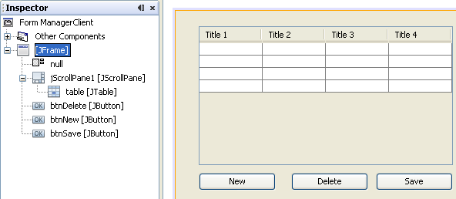
RMI Demo 2.
Client Program

Slide 26
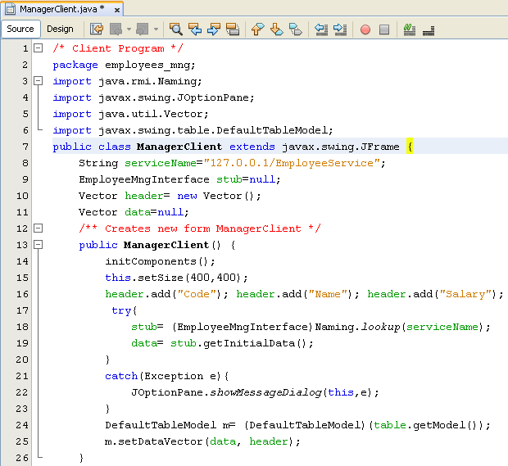
RMI Demo 2.
String serviceName = "rmi://localhost:1098/EmployeeService”

Slide 27
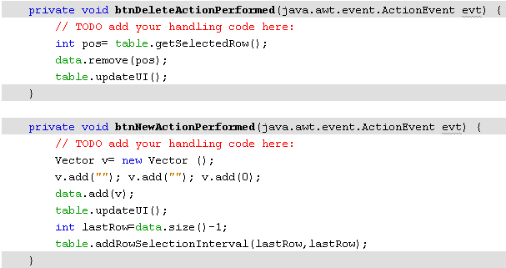
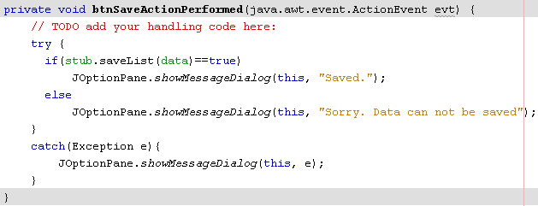
RMI Demo 2.

Slide 28
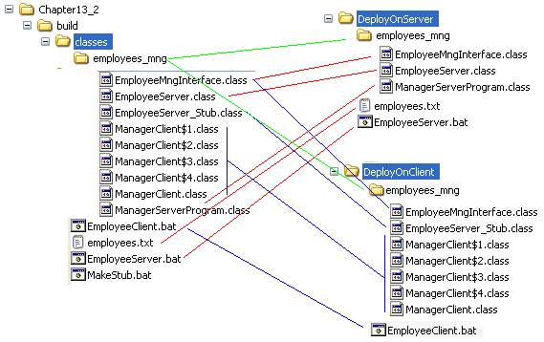



RMI Demo 2. - Deploying

Slide 29
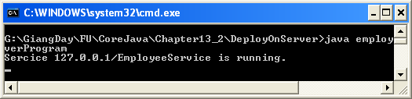
Result:
Step 1- Run server program
Step 2- Run client program

Slide 30
Summary
Remote Control using Object Streams
Remote Method Invocation
Remote interface, Class for Server object
Server Program, Client Program

Slide 31
Thank You

